Slide 1

Proof Obligations in Event-B
Michael Butler
users.ecs.soton.ac.uk/mjb
www.event-b.org

Slide 2
Proof obligation (PO)
A Proof obligation (PO) is a formal property to be proved of an Event-B model
A PO is a sequent of the form Hypotheses ⊢ Goal
This means we should prove the goal while assuming that the hypotheses are true.
Example
x < MAX ⊢ x+1 ≤ MAX
Prove that x+1 ≤ MAX assuming that x < MAX

Slide 3
Proof obligations in Event-B
Well-definedness (WD)
e.g, avoid division by zero, partial function application
Invariant preservation (INV) ***
each event maintains invariants
Guard strengthening (GRD) ***
Refined event only possible when abstract event possible
Simulation (SIM) ***
update of abstract variable correctly simulated by update of concrete variable
Convergence (VAR)
Ensure convergence of new events using a variant

Slide 4
Event structure
E = \\ event name
any
x1, x2, … \\ event parameters
where
G1 \\ event guards (predicates)
G2
…
then
v1 := exp1 \\ event actions
v2 := exp2
…
end

Slide 5
Invariant Preservation PO
Assume: variables v and invariant I(v)
Assume event of this form:
Ev = when P(v) then v := exp(v) end
To prove Ev preserves I(v):
INV: P(v), I(v) ⊢ I( exp(v) )
This is a sequent of the form Hypotheses ⊢ Goal
The sequent is a Proof Obligation (PO) that must be verified

Slide 6
Example
Invariant: x ≤ MAX
Event:
Inc = when x<MAX then x := x+1 end
To prove Ev preserves x ≤ MAX we have this PO:
INV: x<MAX , x ≤ MAX ⊢ x ≤ MAX

Slide 7
Using Event Parameters
Event has form:
Ev = any x where P(x,v) then v := exp(x,v) end
INV: I(v), P(x,v) ⊢ I( E(x,v) )

Slide 8
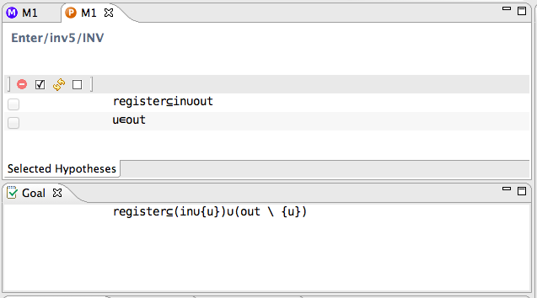
Example PO from Rodin
Invariant
Hypotheses
Guard
Goal

